Slide 1


Client App
Querying
Events & Subscription

Slide 2
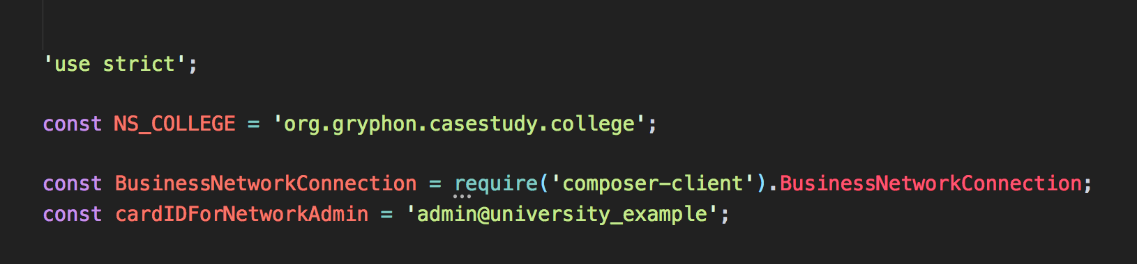
Define Namespace for the transaction
Network Connection class
Admin ID for entering to Network

Slide 3
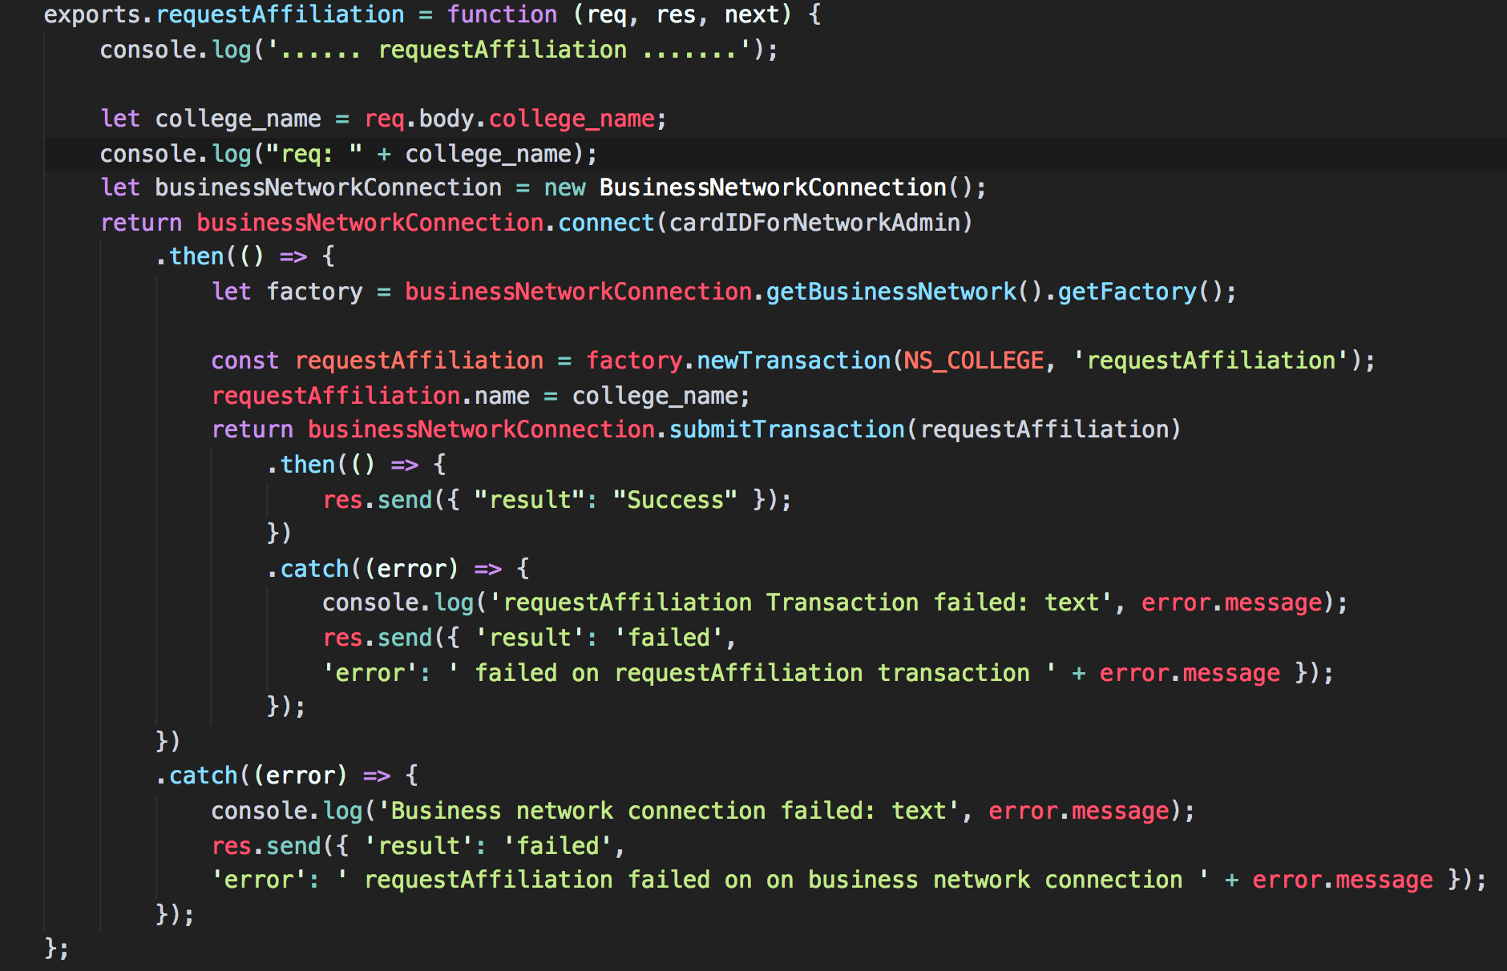
Fetch input arguments
Connect to the Business Network
Create Transaction Object
Assign input parametes to transaction Object and Submit Transaction

Slide 4
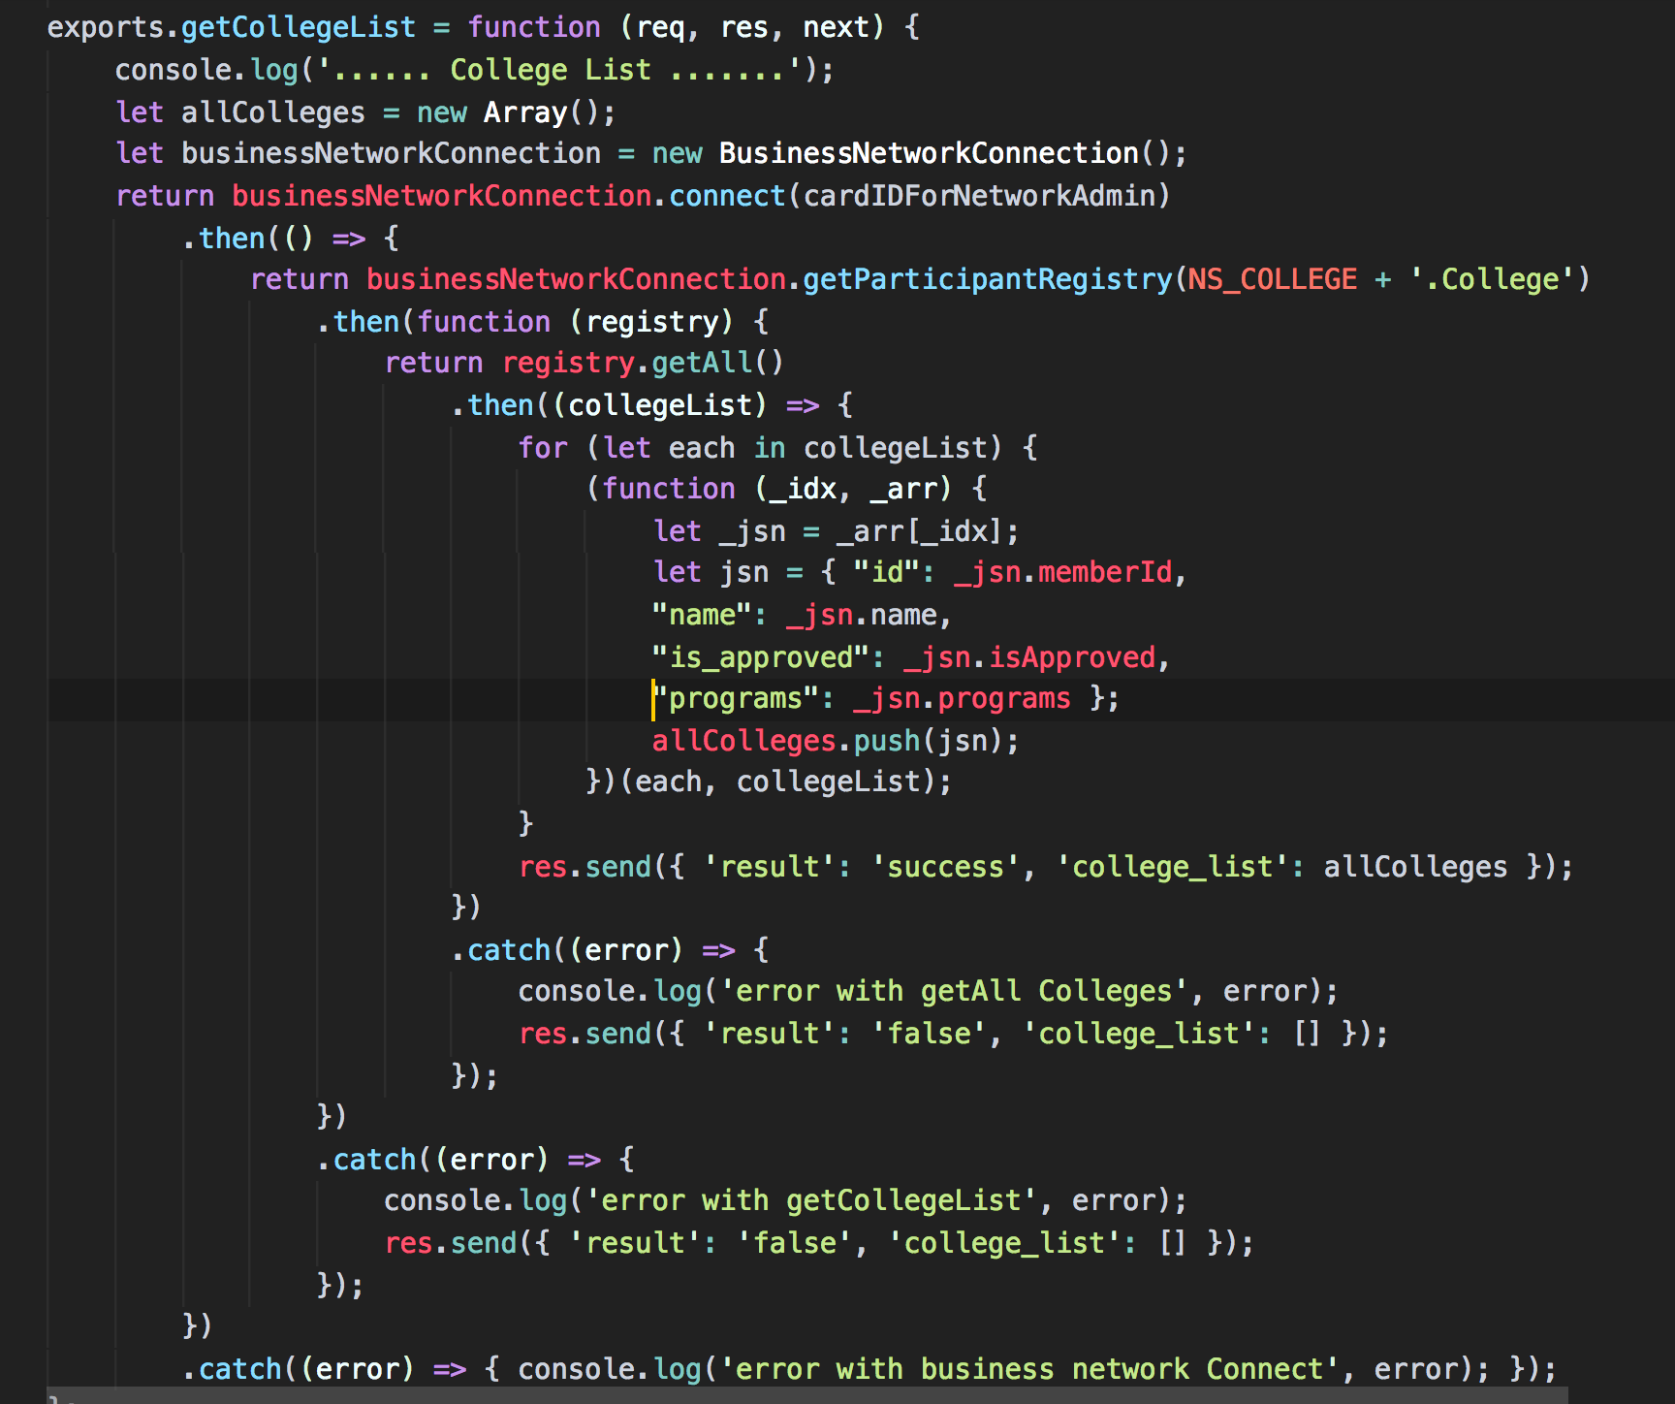
Connect to the Business Network
Get College Participant Registry
Contruct json array for return

Slide 5
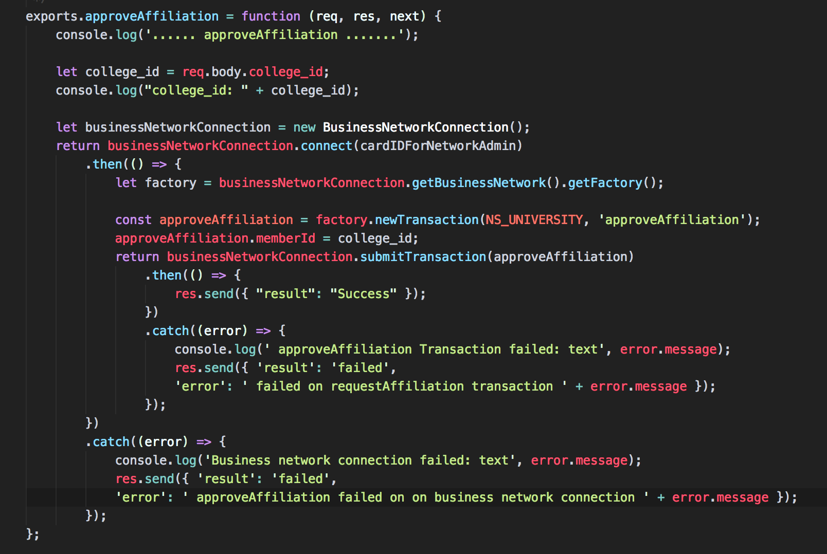
Fetch input arguments
Connect to the Business Network
getFactory() object for access to chaincode
Create Transaction & Assign arguments
Submit Transactions

Slide 6
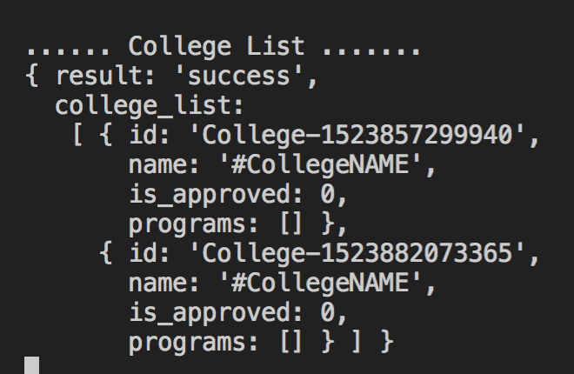

Slide 7
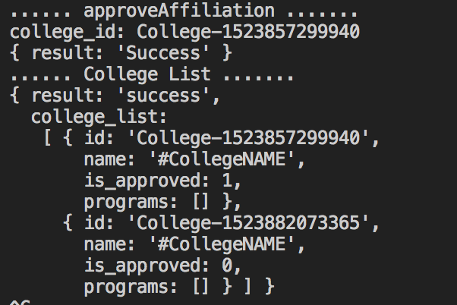

Slide 8
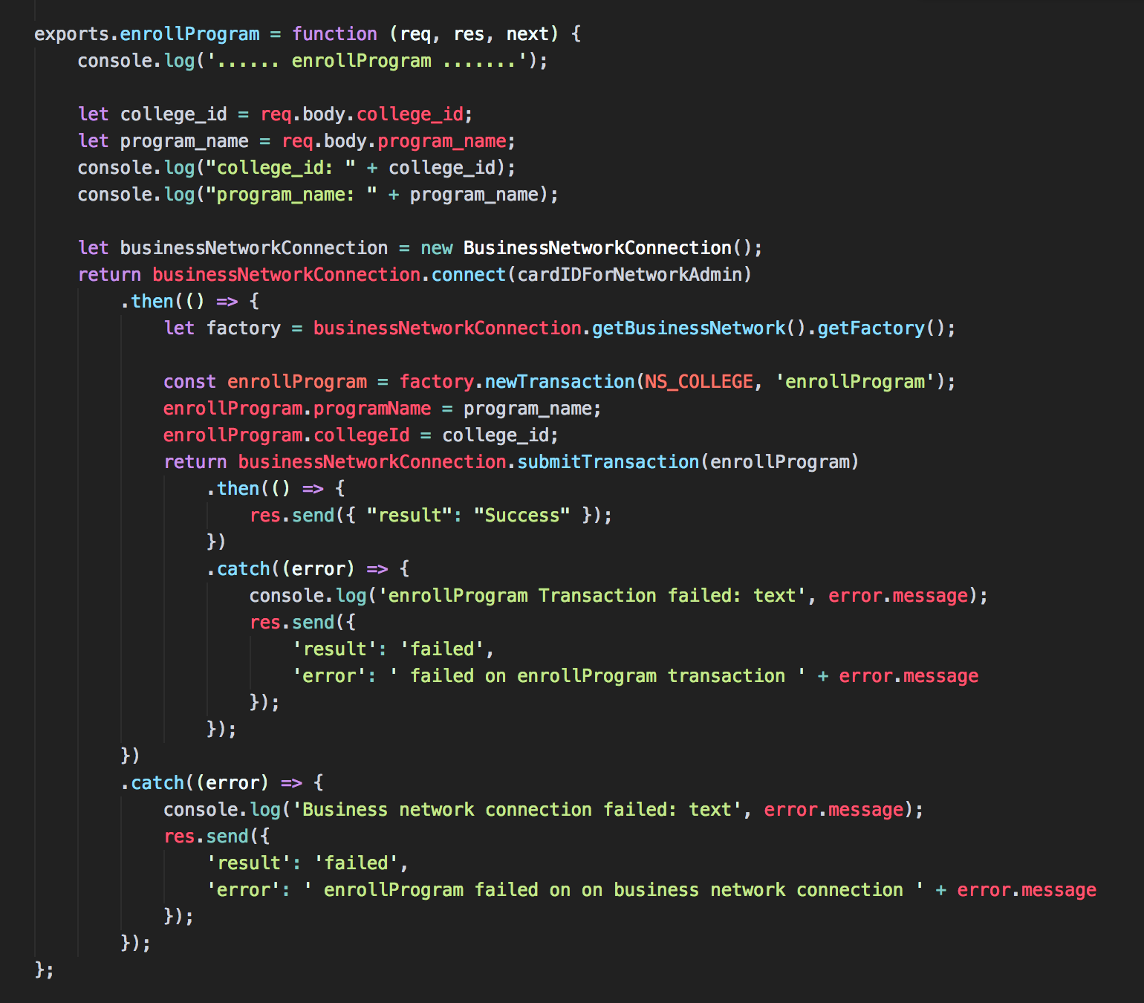
Fetch input arguments
Connect to the Business Network
getFactory() object for access to chaincode
Create Transaction & Assign arguments
Submit Transactions

Slide 9
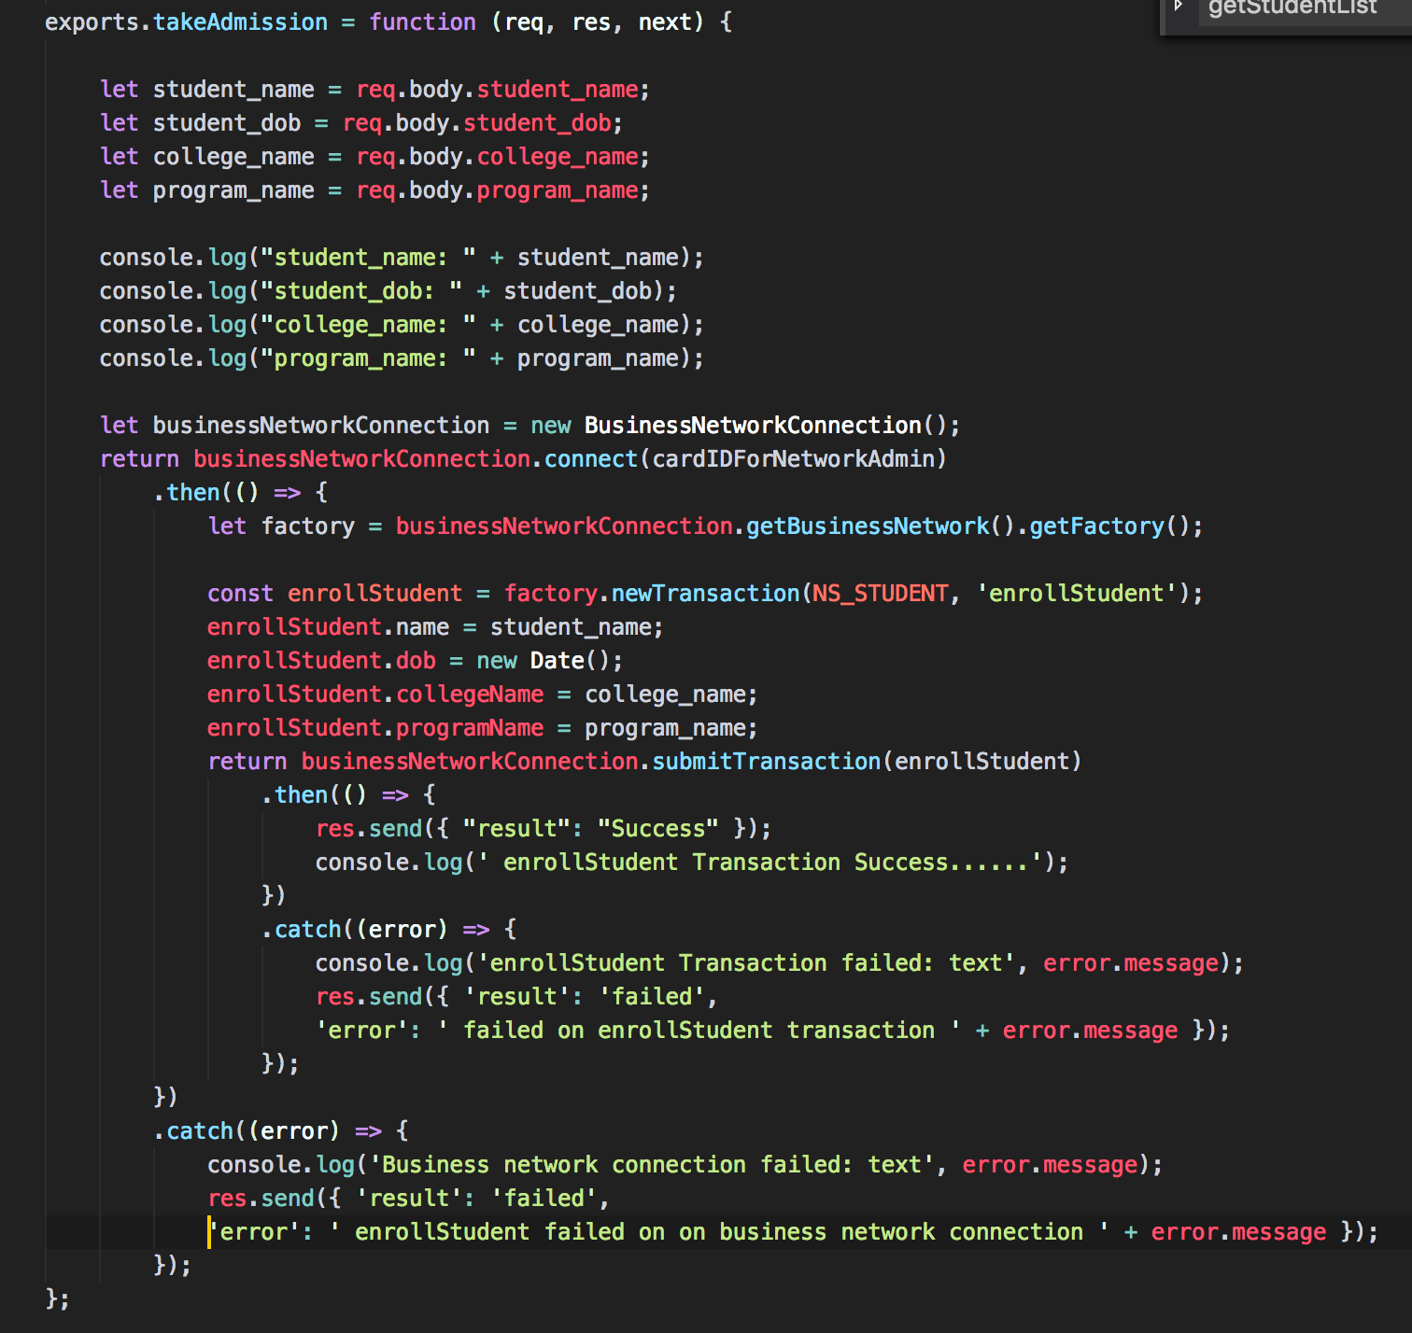
Fetch input arguments
Connect to the Business Network
getFactory() object for access to chaincode
Create Transaction & Assign arguments
Submit Transactions

Slide 10
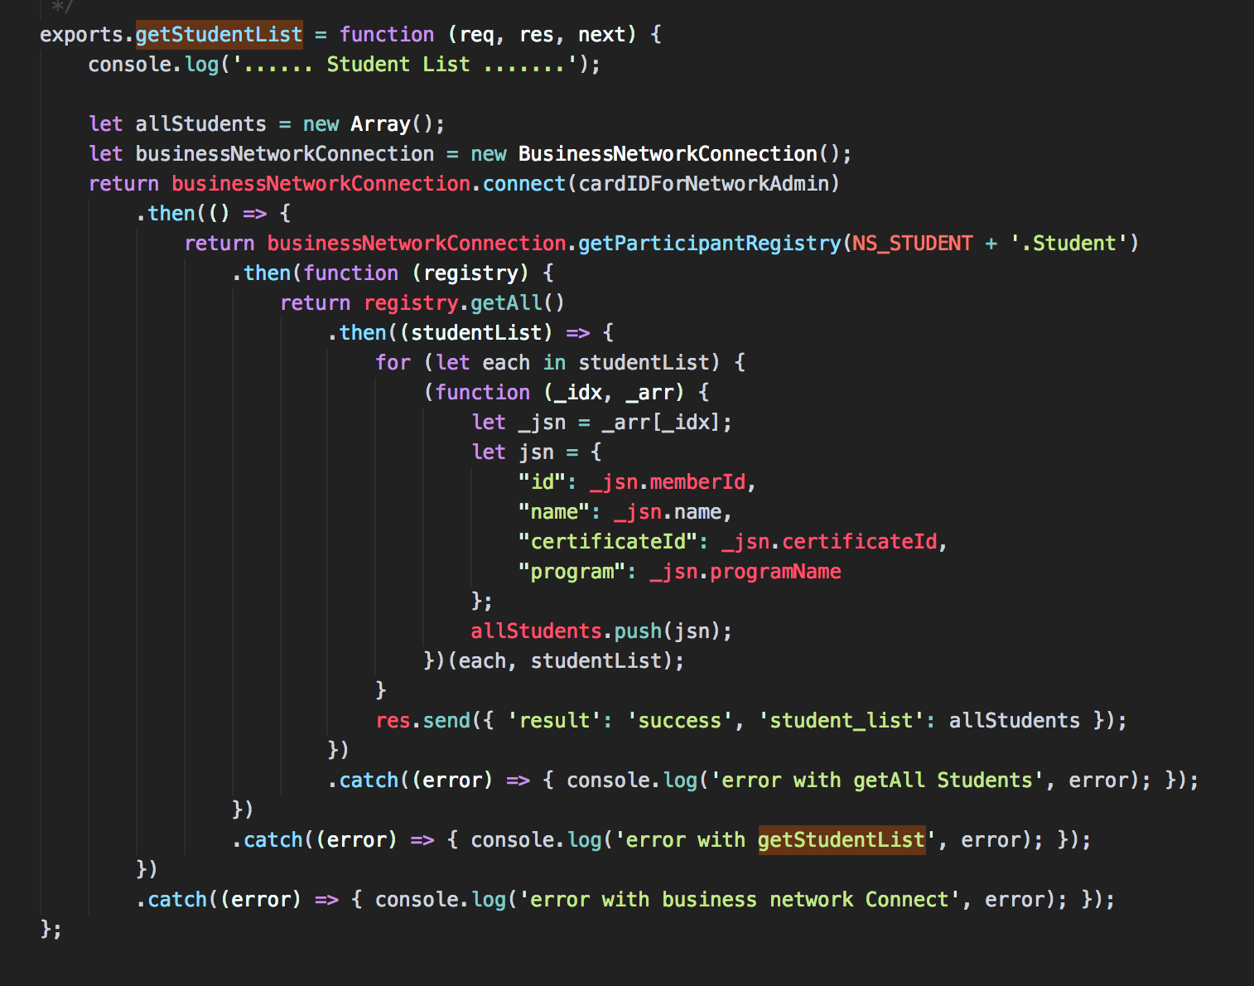
Connect to the Business Network
Fetch Participant Registry
Make return json object
Send Response Data

Slide 11
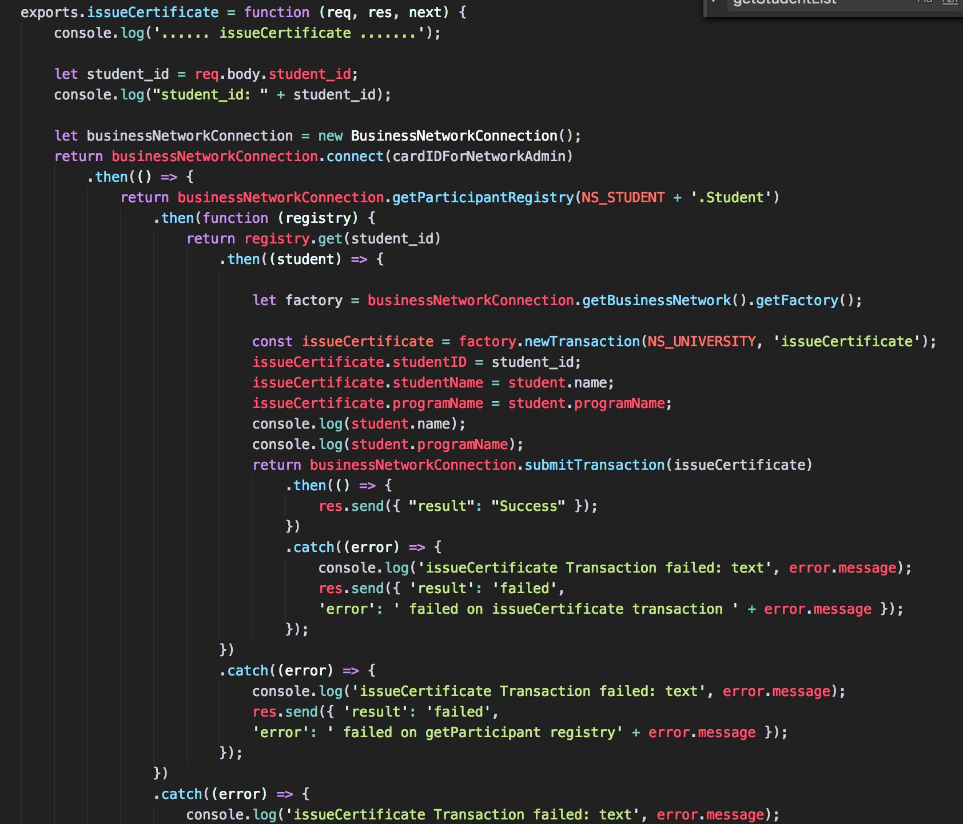
Fetch input arguments
Connect to the Business Network
Get Student Participant Registry
Create Transaction & Assign arguments
Submit issueCertificate Transactions

Slide 12
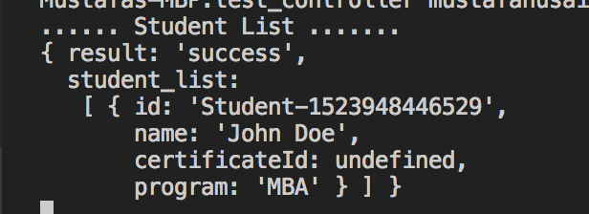
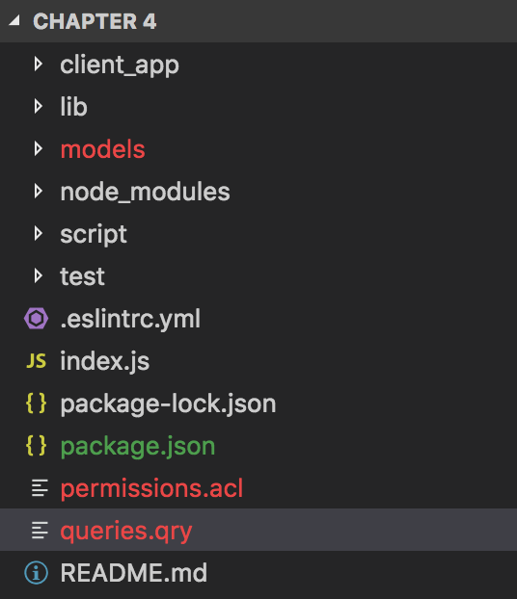

Slide 13
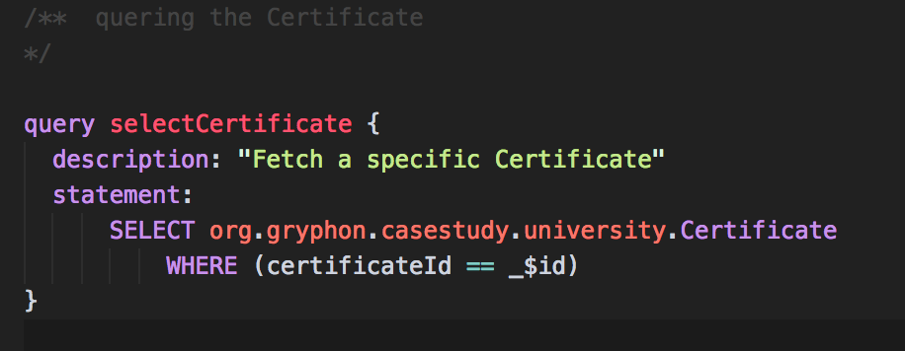
Name of Query we will use it to call from client App
Description can be used for readability & maintenance
Resource to query
WHERE clause for filter

Slide 14
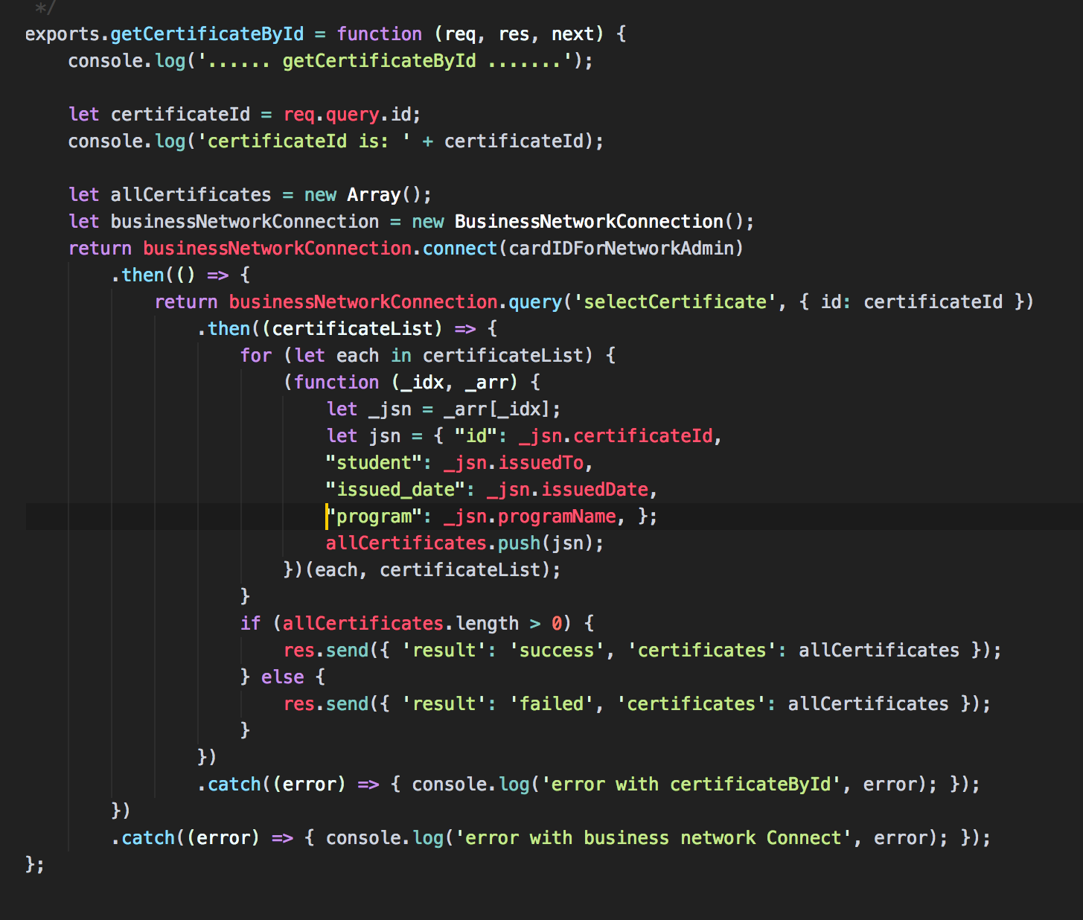
Fetch input arguments
Connect to the Business Network
Call Query with inputs as student ID
Process Results & build json object
Send the response json object

Slide 15
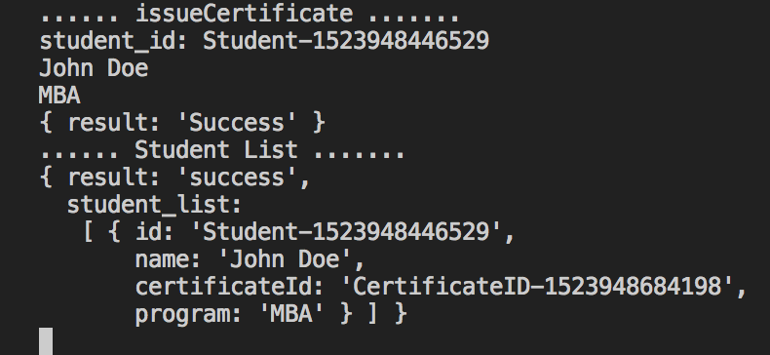

Slide 16
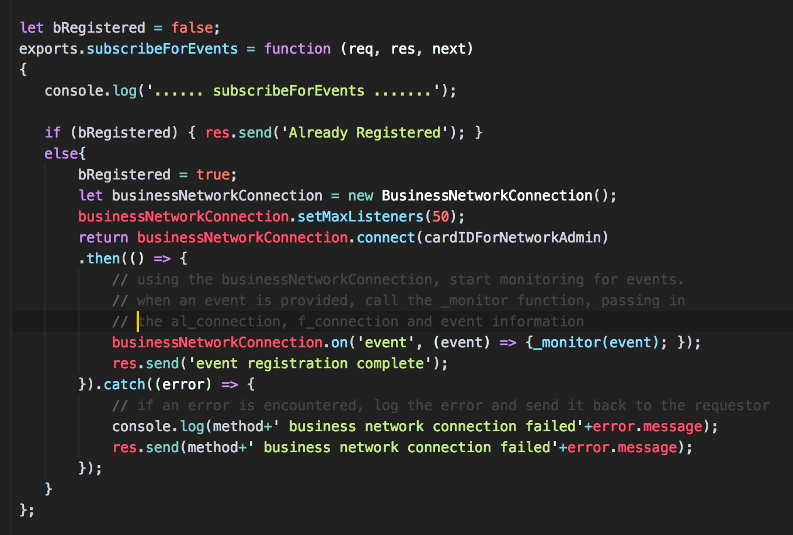
Check if already registered
Connect to the Business Network
Set Listner Limits
Subscribe to Event

Slide 17
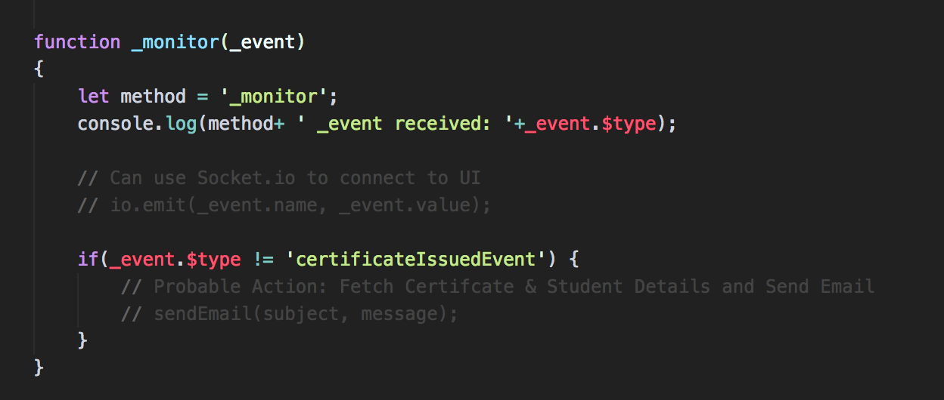

Slide 18
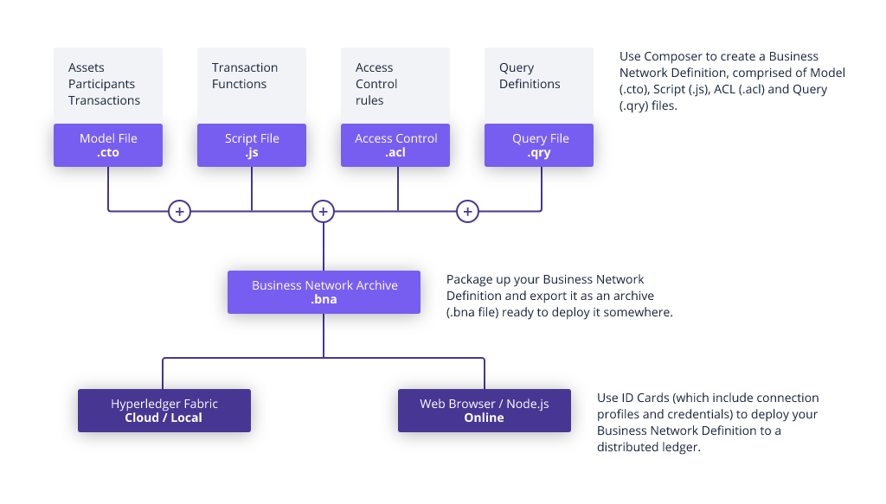
Composer Rest Server
Composer SDK
Client App

